Slide 1
Spin-down Procedures
Lunatic Labs

Slide 2
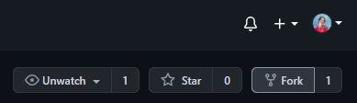
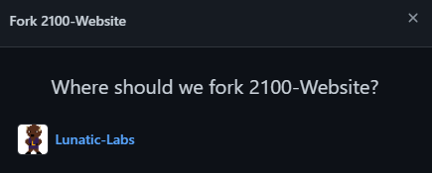
Make sure all your files are accessible!
Top right of page
Push all local files to GitHub
Check to make sure all local branches are pushed to GitHub
If you have any repositories needed for your project on your personal GitHub account, move them to the Lunatic Labs organization
You can easily do this by forking the project into the LL organization

Slide 3
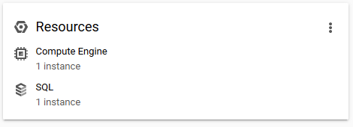
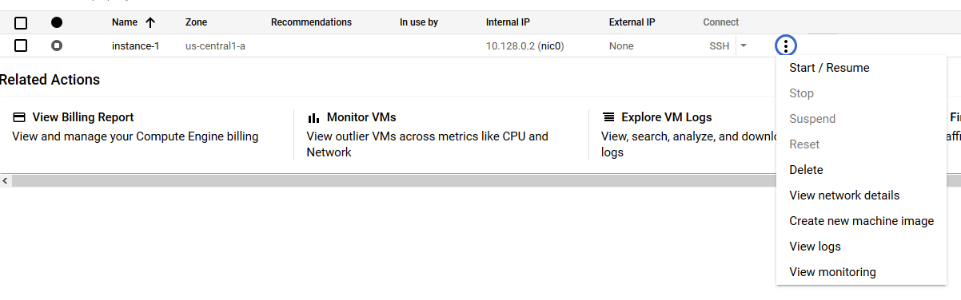

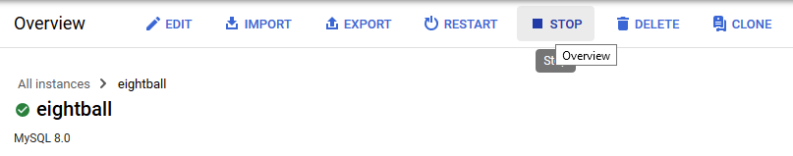
Spin down Cloud Services
Fig 1
To save on resources it is important to spin down your google cloud resources.
On the homepage for the console there is a Resources block (fig 1)
Click on the resources you have available, such as compute engine or SQL
For a compute engine. Click on the three circle button once the instance list and click stop. You know it works when the circle turns grey with a white square (fig 2)
For some resources you will need to go into the instance’s page itself and click stop at the top of the page (fig 3 & 4)
Fig 2
Fig 3
Fig 4

Slide 4
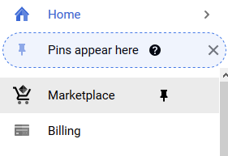
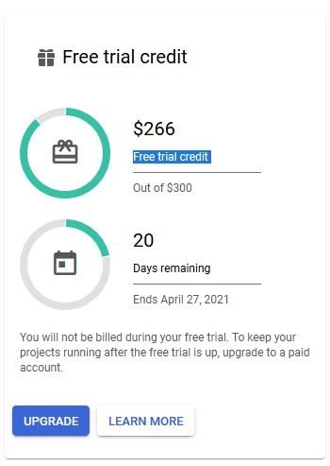
Spin down Cloud Services - Billing
Fig 1
Check your billing page to ensure that there is no predicted cost.
To navigate there go to the side panel and click Billing. (fig 1)
It is likely that you are still using a free trial account or educational credit. These accounts will not charge you unless you using a service. Even if you have left over credits you can preserve them for future projects by ensuring all resources are spun down.
Fig 2

Slide 5
Spin-down Misc
Loose files:
Google Drive
Configuration Files
Diagrams: ERD, Design Documents, Wireframes, etc.
Access Control:
Usernames
Passwords
Encryption keys and other access data.

Slide 6
README
Contents
Goal / Mission statement for the project.
Description of Application’s Architecture/Tool Stack.
Guidelines for configuration, installation, and operation of your project:
List of pre-required installs and necessary dependencies.
Step by step deployment tutorial for every layer of the application.
Description of unique classes/algorithms proprietary to your project.

Slide 7
Status Timeline
Access to, or a snapshot of, the current groups method of tracking progress (Trello, SCRUMs, etc.)
Clear delineation of the following:
Items that are “done”
Items still “in-progress”
Remaining items for the project to be complete.

Slide 8
Contact Info
In the corporate world ideally you’d like to have a code review with the previous developers on the brownfield project your inheriting, this doesn't always happen.
For returning students leave an email or other contact info in the README or project status documentation.

Slide 9
Questions?

